Slide 1

Floating-Point Representation, Fixed-point Representation and Conversion
Keyvan Shahin
Prof. Dr.-Ing. habil. Michael Hübner
Chair for Computer Engineering
Brandenburg University of Technology Cottbus - Senftenberg

Slide 2
Outline
Motivation
Introduction to number representations
State of the art
Idea Introduction
Future steps

Slide 3
Motivation
Advances in implementing DSP and telecommunication in semiconductor technology
Costs: Silicon Area, Power Profile, Execution time
Productivity and Time-To-Market
Floating- and Fixed-point arithmetic operations
The importance of Fixed-point arithmetic operations in satisfying the requirements

Slide 4
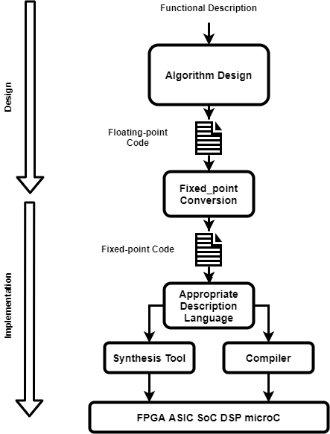
Big Picture
Functionality Description
Algorithm Design in Floating Point Domain
Conversion
Description of Hardware
Synthesis/Compile
Programming the Target Platform

Slide 5
Why?
The conversion can take 30% of the design time
HLS tools for converting the C/C++ codes to RTL
Fixed-point conversion is the bottleneck for fast development
Automatized Conversion is essential

Slide 6
Number Representation
Binary numbers
Rules for carrying out arithmetic operations
Limited number of bit and precision
High computation and storage demand in DSP algorithms
Importance of representation format
Two aspects of representation
Dynamic Range -> Integer Word-Length
Accuracy -> Fractional Word-Length
Two representations
Floating-Point Representation
Fixed-Point Representation

Slide 7
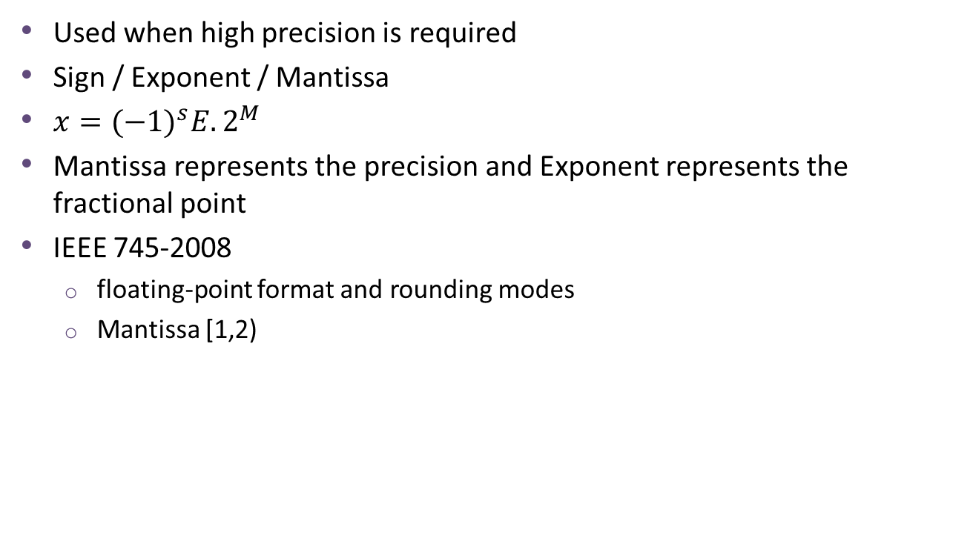
Floating-point Representation
Used when high precision is required
Sign / Exponent / Mantissa
$x={(−1)}^{s}E.2^{M}$
Mantissa represents the precision and Exponent represents the fractional point
IEEE 745-2008
floating-point format and rounding modes
Mantissa [1,2)

Slide 8

Fixed-point Representation
Integer Part and Fractional part
Widths are fixed
Two’s complement encoded
$x=−2^{m}S+\sum_{i=−n}^{m−1}{b_{i}.2^{i}}$

Slide 9
Comparison
Wide Dynamic range for Floating point
Sensitivity of Fixed-point to quantization error
Less expensive and faster functionality of fixed-point hardware
Higher accuracy and dynamic range with floating-point hardware

Slide 10
Conversion
Conversion of floating-point representation into a fixed-point representation
Two steps:
Integer Word-Length
With overflow probability
No overflow
Fractional Word-Length

Slide 11
State of the art and the idea
Traditional way is to do everything by hand
Some lemmas in publications on how to minimize the search space and early termination of bad width configurations
PhD thesis from Universite Bretagne Loire (2008-2017) (ID.Fix tool)
Fixed-point conversion of a C source code
What is done
The ID.Fix tool tried to automatize the Fix-point conversion on software
C code to C code Conversion
How can it become better
Do the simulation on hardware for faster simulation execution / possibility of more exhaustive simulation
Convert the C code to human-readable VHDL code

Slide 12
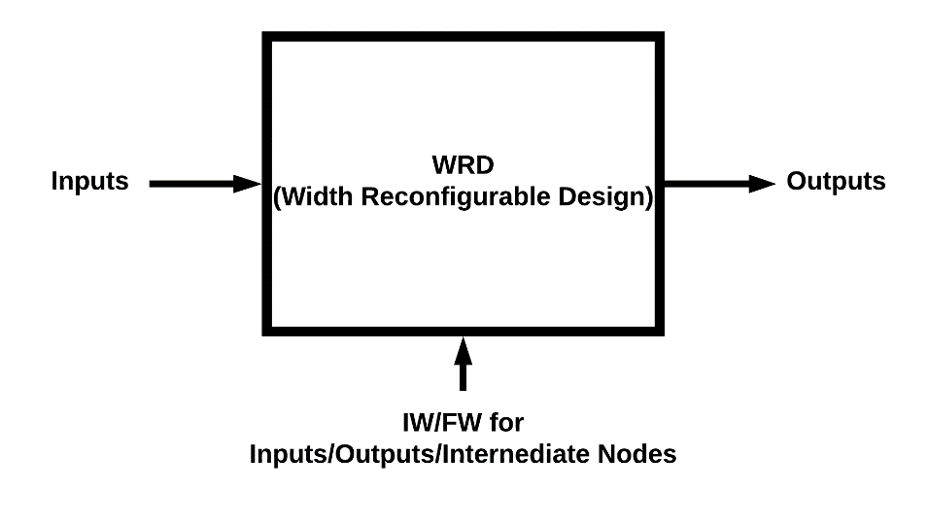
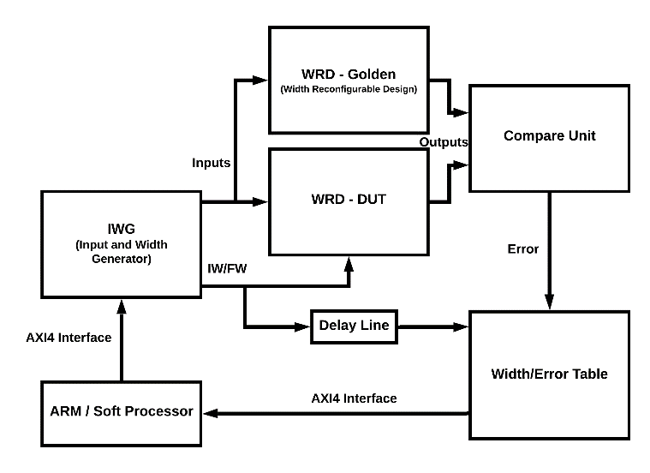
Big Picture
WRD:
The DSP algorithm
Inputs / Output / Integer and Fractional Widths
IWG:
Essentially the simulation control unit
Compare Unit
Different metrics of decision if the results are acceptable
Interface with A Hard/Soft Processor

Slide 13
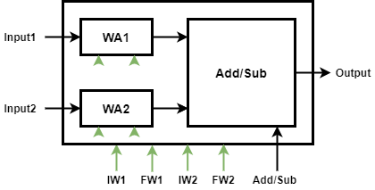
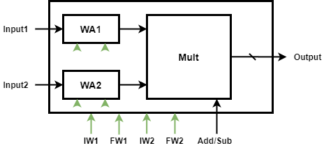
Arithmetic Operations Implementation Approach
Complexity of automatization of generating a width reconfigurable hardware for case-by-case approaches
Use of polynomial approximation as the implementation approach
Multiplication and Addition/Subtraction will be the building blocks

Slide 14
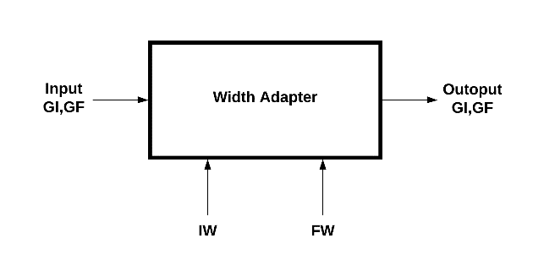
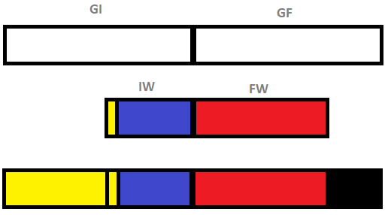
Width Adapter Module
Definitions:
Golden/Ideal Integer and Fractional Widths
Used for connecting the adders / multiplication to each other
Widths of the adders and multiplier at the core of the reconfigurable adder/multiplier blocks
Local reconfigurable Integer and Fractional widths
The target precision of each variable
Width Adapter is a gateway between these different widths
Zero Padding and Sign Extension

Slide 15
Future Work
Obvious steps
Finish the implementation of building blocks
Proof of operation by hand-writing some designs
Read more papers and the software thesis in more depth
Writing a PhD Forum / papers / Proposal
The VHDL hardware generation script development with the experience from EXTRA

Slide 16
Thank you for your patience
Questions?

